Slide 1
Sustainable AI Project
Energy-Efficient Prompt & Context Engineering
CSCN8010 – Foundations of Machine Learning Frameworks

Slide 2
Introduction
The project focuses on designing a transparent and sustainable AI system by:
Monitoring and reporting energy consumption of LLM prompts.
Optimizing prompts for lower energy usage without compromising performance.
Encouraging eco-conscious development and deployment practices.

Slide 3
Project Objectives
Build a tool that estimates energy usage of AI prompts.
Create a recommendation system for optimizing prompts.
Analyze and report prompt complexity and token count.
Design an interactive Streamlit GUI for usability.

Slide 4
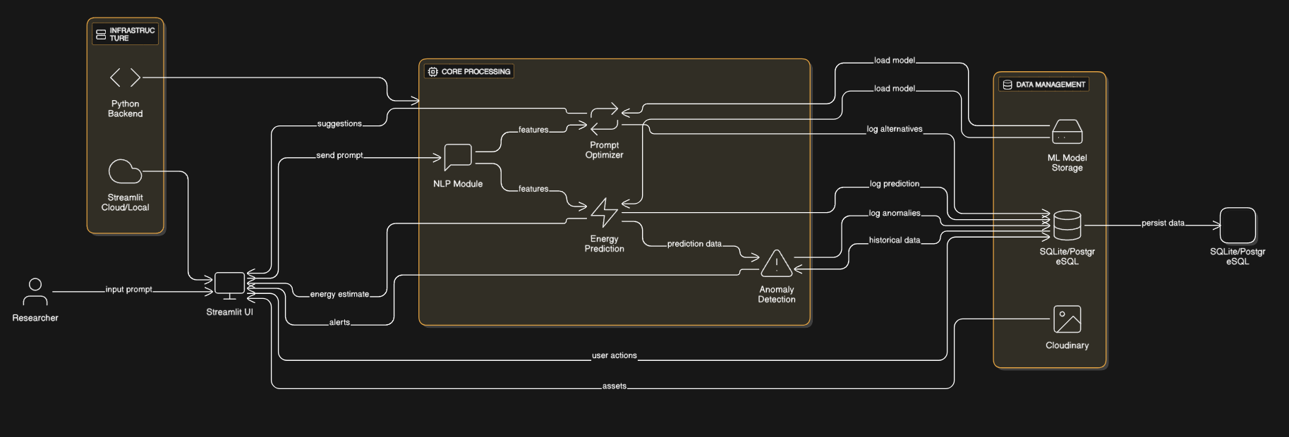

Slide 5
System Architecture Overview
The architecture includes:
Input Module: Accepts user prompts and context
Feature Extraction: Token count, complexity, embeddings
Energy Prediction: RF/NN models estimate consumption
Prompt Optimization: Embedding-based semantic refinement
Output Module: Streamlit GUI displaying results and graphs

Slide 6
NLP Preprocessing: Tokenizer, Readability, Complexity
Purpose: Converts raw text prompts into measurable numerical features for downstream analysis.
Tokenizer:
Uses Hugging Face Tokenizers to split the prompt into tokens.
Token count is critical because larger token sizes generally require more computation and energy during inference.
Readability & Complexity:
Uses libraries like textstat to calculate readability scores
Complexity score captures linguistic difficulty — more complex prompts often demand more computation from the model.

Slide 7
Energy Predictor: ML Model for Estimating Power Usage
Purpose: Predicts the expected energy consumption (in kWh) of running the prompt on a chosen AI model.
Models Used:
Random Forest Regressor (Scikit-learn) for non-linear feature relationships.
Neural Network (PyTorch or TensorFlow/Keras) for learning complex interactions between features.
Input Features: token count, complexity score, model parameters (layers, FLOPs/hour, etc.).

Slide 8
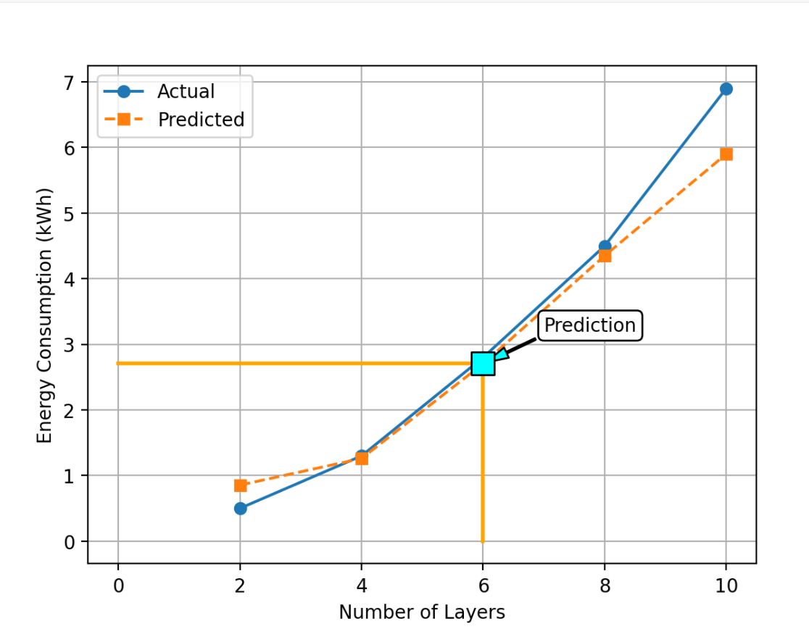
Results

Slide 9
Anomaly Detection
Algorithm: Isolation Forest
Input Features: Token count, complexity score, predicted energy usage
Purpose: Detect unusual energy consumption patterns in AI prompts
Workflow:
1. Preprocess user input data
2. Apply trained Isolation Forest model
3. Flag anomalies for review

Slide 10
Prompt Optimizer: Eco-efficient Rephrasing Purpose: Suggests alternative prompts that maintain meaning but reduce computational load. Techniques Used: SentenceTransformer (all-MiniLM-L6-v2) for semantic similarity — ensures the optimized prompt is close in meaning to the original. T5 Paraphraser from Hugging Face to generate low-token paraphrases. Goal: Reduce token count and complexity → lower energy usage without losing meaning.

Slide 11
Dataset and Features
Dataset: CSV file with prompts, model config, energy data
Features:
Token count
Readability score
Sentence complexity
Prompt length

Slide 12
Model Development
Feature engineering from NLP metrics
Train regression models (Random Forest)
Evaluate using MAE, RMSE, R²
Save and integrate model into backend

Slide 13
Streamlit GUI Overview
The Streamlit GUI provides:
Prompt input box for user queries
Real-time NLP analysis: token count, readability score
Energy prediction chart with model outputs
Anomaly alert if predicted energy exceeds threshold
Clean, mobile-friendly interface

Slide 14
Conclusion
The project demonstrates how AI systems can be engineered to be energy-efficient and transparent using ML and NLP.
This approach enables transparency in AI prompt energy usage.

